Slide 1

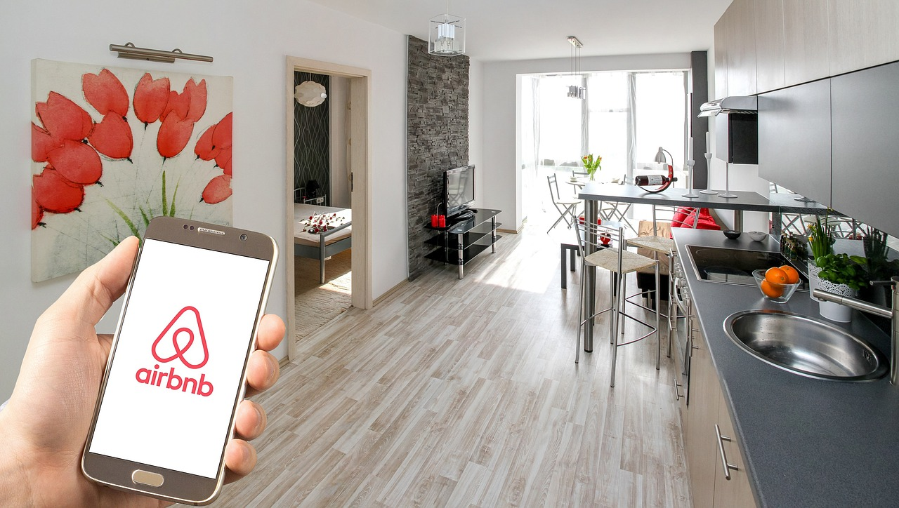
Web Scraping AirBnb and hotels.com
“Price Analysis and Comparison”
Priya Srivastava
NYC Data Science Academy
May 7th , 2019

Slide 2
Overview
About the businesses
Why do we care?
Web Scraping challenges and solution
Data Analysis
Conclusion
Future Work and Github
Questions

Slide 3
About the Businesses
airbnb
hotels.com
Airbnb is a community-based online platform for listing and renting local homes. It connects hosts and travelers and facilitates the process of renting without owning any rooms itself. Moreover it cultivates a sharing-economy by allowing property owners to rent out private flats.
Founded: 2008 / San Francisco
Hotels.com is a website for booking hotel rooms online and by telephone. Its inventory includes hotels and B&Bs, and some condos and other types of commercial lodging. It has a commission based business model.
Established: 1991 Dallas, Texas

Slide 4



Why do we care?
Price
comparison
Best vacation experience
Business Improvement

Slide 5
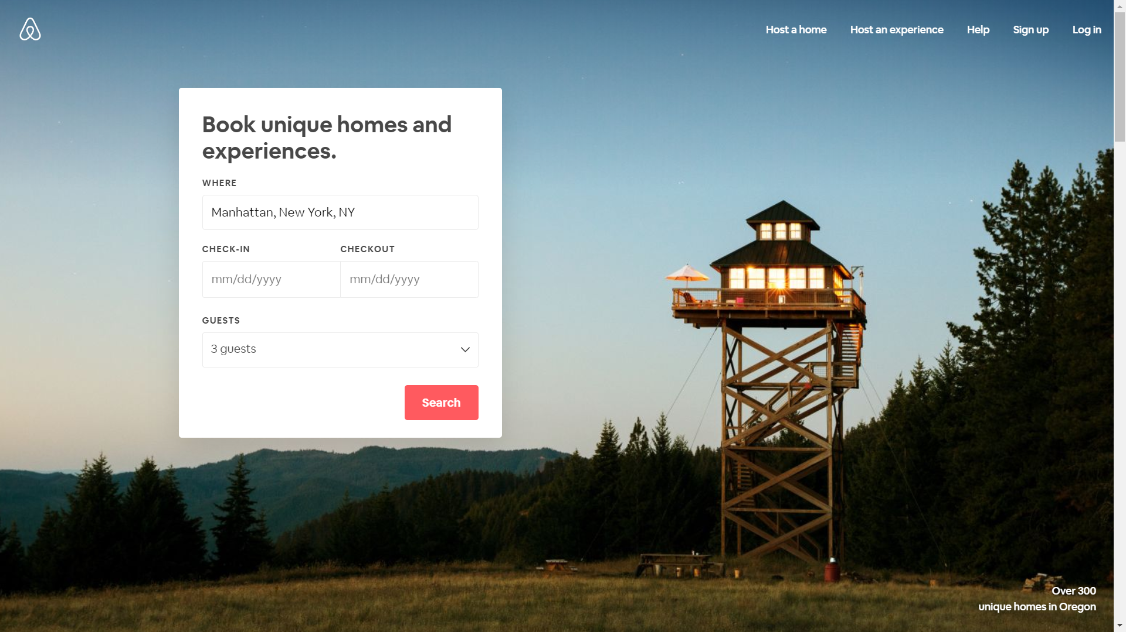
Web Scraping : Challenges and Solution
Tool: Selenium
Website: www.airbnb.com

Slide 6
Challenge: Must provide location (limits scrapings capability of all locations
Solution : Generated url with location and used as start url
Challenge: Data loaded by AJAX; Scrapy Xpaths didn’t work
Solution: Used Selenium
Another option: Scrapy Splash
Challenge: Dataset restricted to 17 pages, after 17 pages it sends you back to page 1
Solution: I scraped two locations and 17 pages per locations.

Slide 7
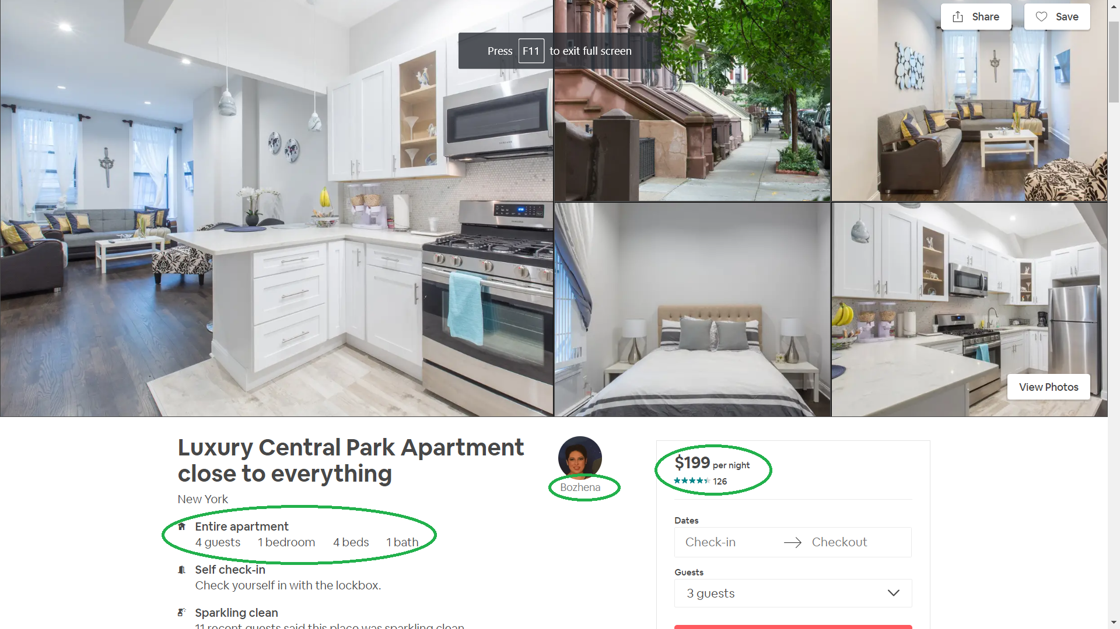
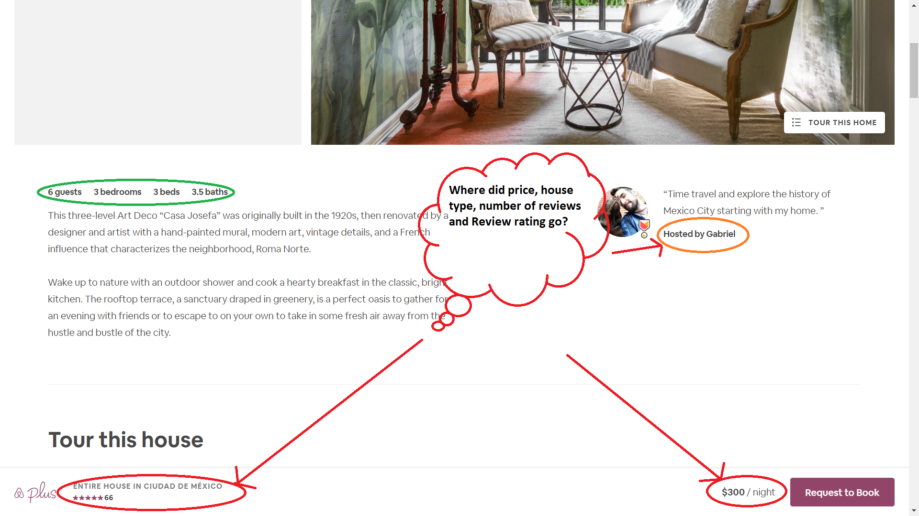
Challenge:
Dynamic page rendering
Solution:
Grabbed different sets
of Xpath based on different page layout

Slide 8
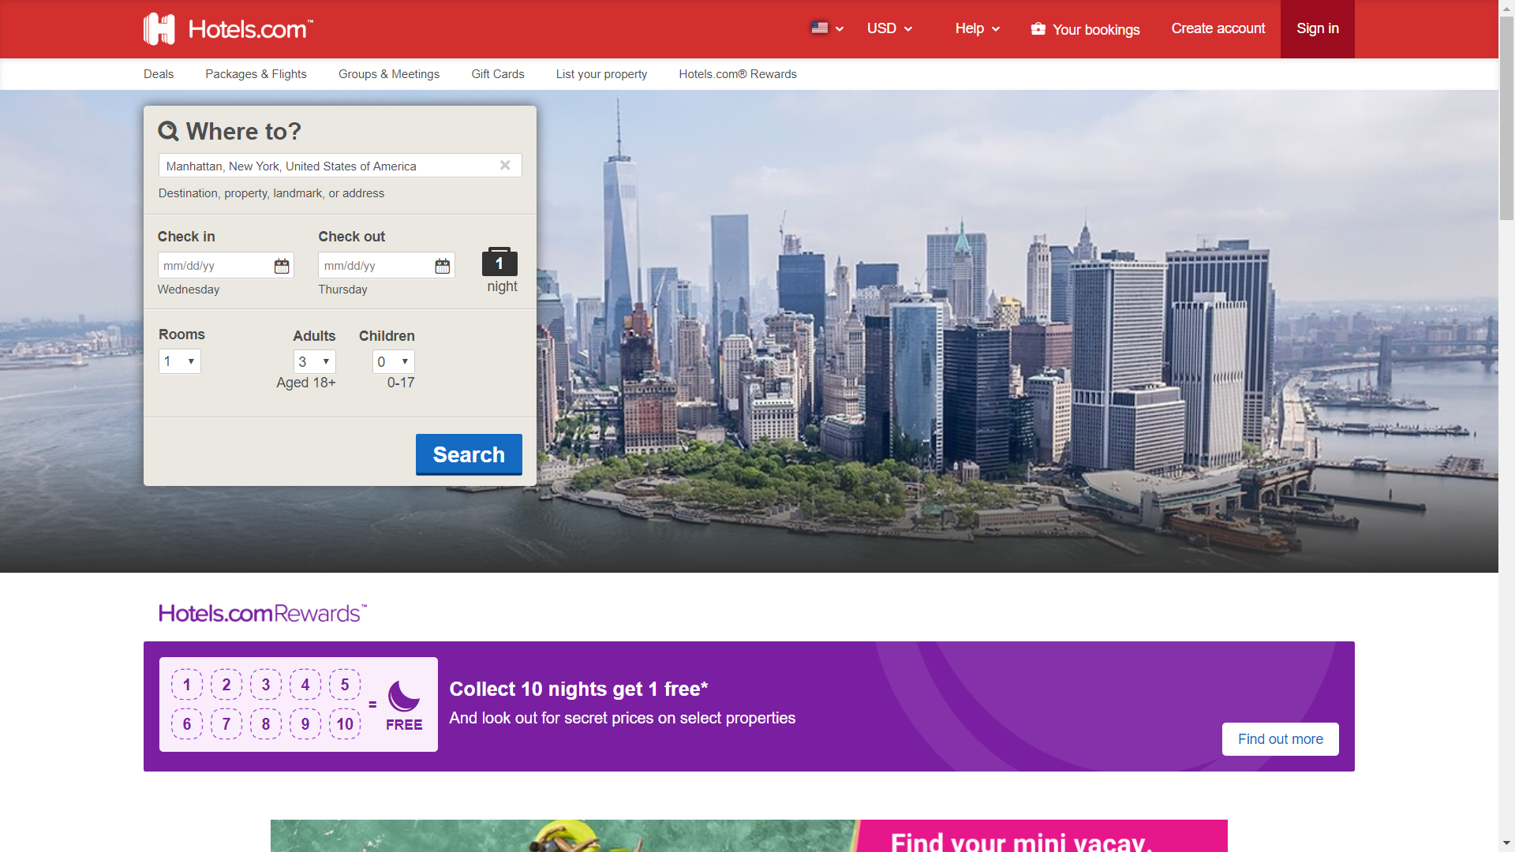
Web Scraping : Challenges and Solution
Tool: Selenium
Website: www.hotels.com

Slide 9
Challenge: Must provide location (limits scrapings capability of all locations
Solution : Generated url with location and used as start url
Challenge: The page loads on scroll, no next button to click and get next set of listings.
Solution: Used window.scrollTo() method, to scroll and load the listings. Saved the listing hrefs in list, then iterated over each links to scrape the required data.

Slide 10
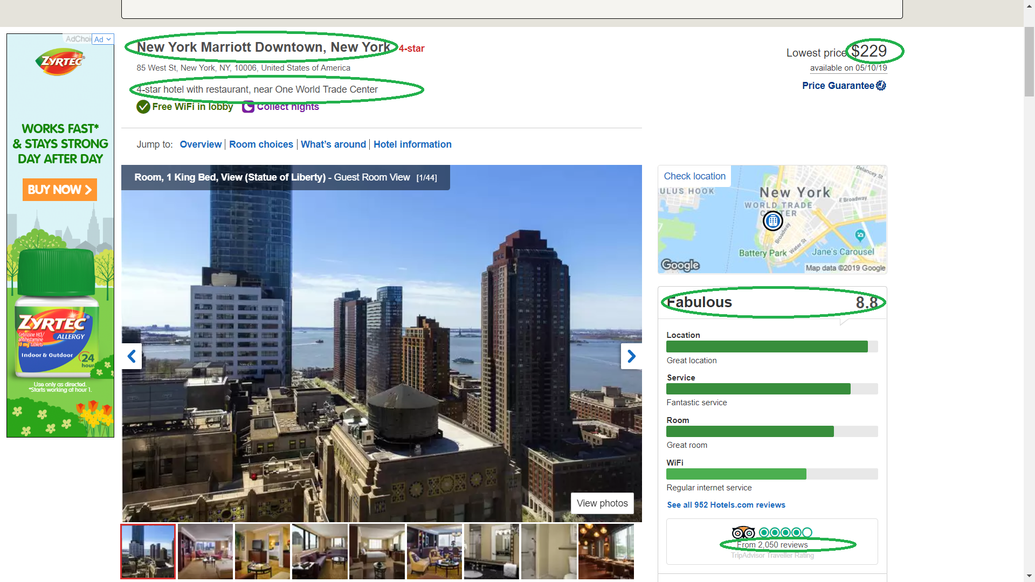
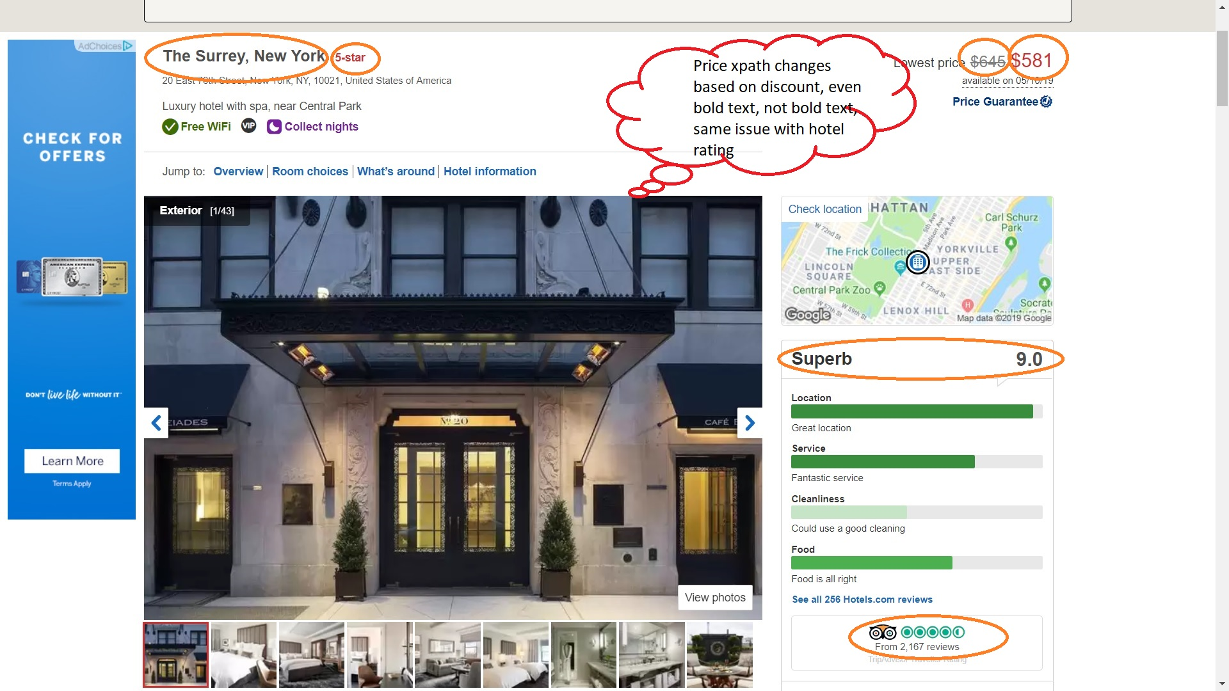
Challenge:
Dynamic page rendering, hotel price xpaths change, hotel star xpaths change
Solution:
Grabbed different sets
of Xpath based on different page layout

Slide 11
AirBnb
Sample of Scraped Data
Sample of Data after cleaning and manipulation

Slide 12
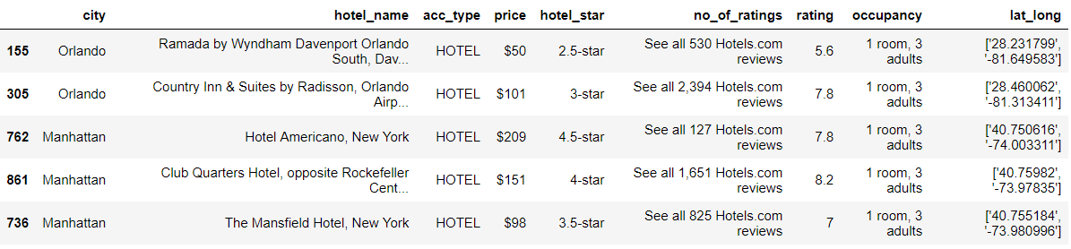
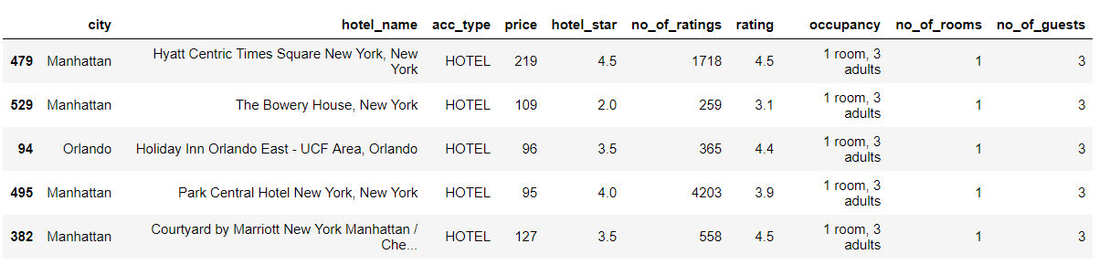
Hotels
Hotels: Sample of Scraped Data
Hotels: Sample of Data after cleaning and manipulation

Slide 13
Data Analysis
Compare factors influencing AirBnb prices
How prices vary based on different type of location
What kind of accommodation fits my budget based on number of people travelling
Compare factors influencing Hotel prices
Compare AirBnb business to Hotels.com business

Slide 14
Scipy Two sample t-test on airBnb price and Hotels price
stats.ttest_ind(airdf.price, hoteldf.price)
Ttest_indResult(statistic=-6.462759938122756, pvalue=1.482752809922366e-10)
→ The results show p-value is extremely small. This indicates that hotels and airbnb prices are unlikely to have the same mean
→ Hotel price and AirBnB prices are statically different

Slide 15
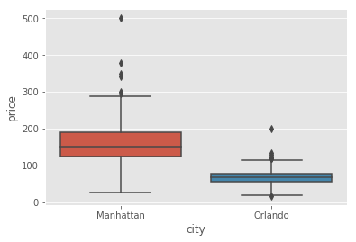
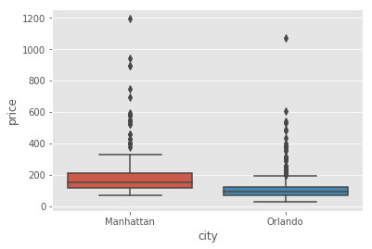
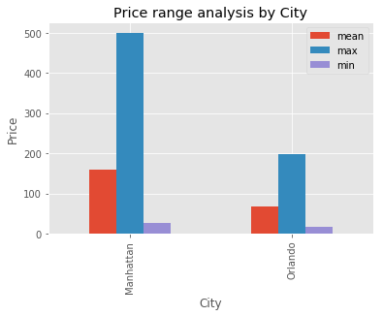
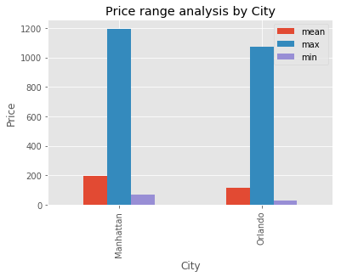
AirBnb
Hotel

Slide 16
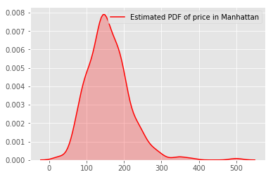
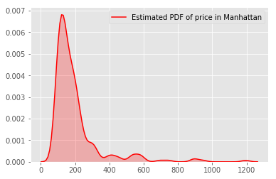
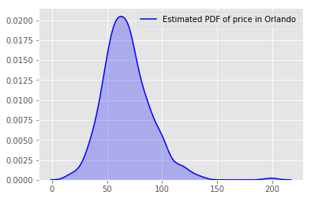
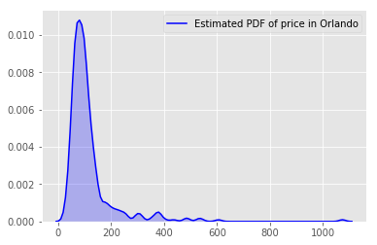
AirBnb
Hotel

Slide 17
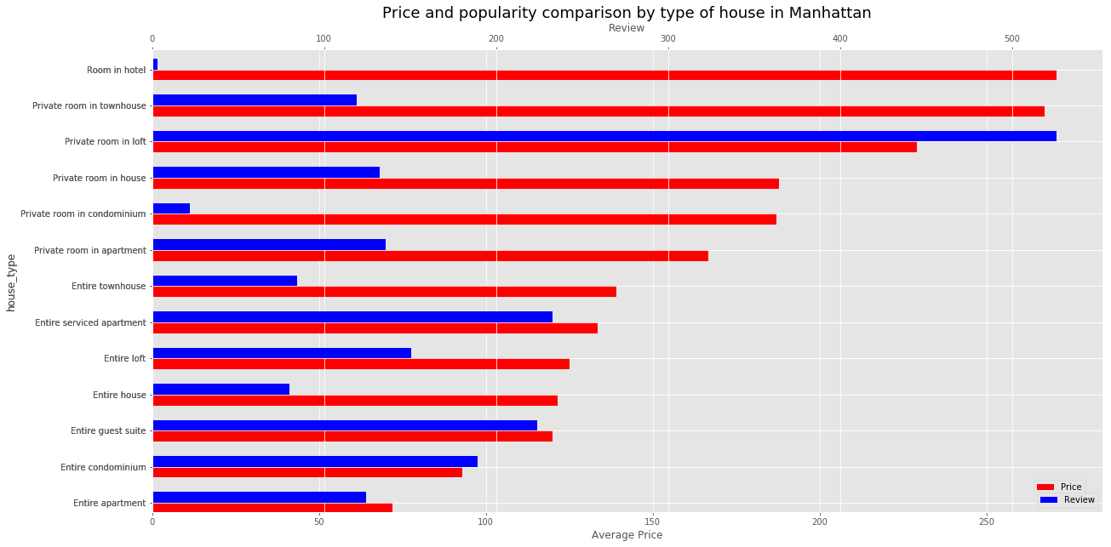
AirBnb
Popularity is defined by most highly rated and highly booked/reviewed places
“Private room in loft” is the most popular rental type as is priced on an average of $225/night.
“Entire Serviced apartment” and “Entire guest suite” are next two popular ones and are moderately priced around $120 -$130 on an average. “Room in hotel” is the least desired one and is highly priced

Slide 18
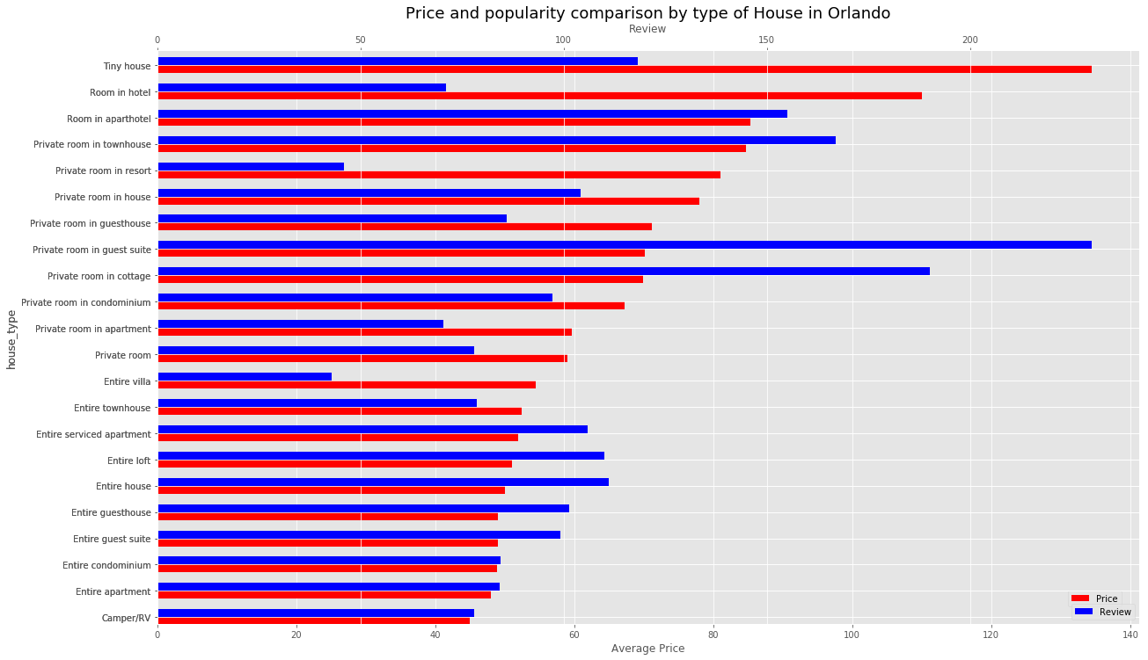
AirBnb
However, in Orlando, “Room in hotel” has higher stakes than Manhattan.
The most popular accommodations are “Private Room in guest suite” and “Private room in cottage” which are moderately priced only $70 per night on an average.

Slide 19
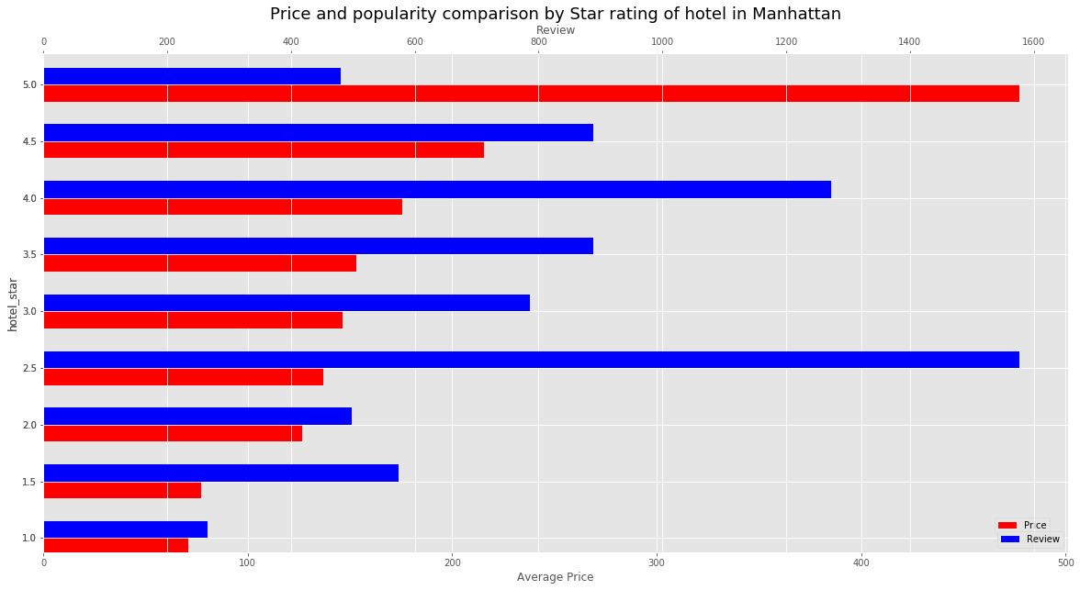
Hotels
As expected 5 star hotels are less popular because of sky high price, and 1 star hotel hotels are cheap but provide bad experience/service, hence less popular. These 1 star hotels would cost you around $70. Most popular ones are 2.5 star hotels and are priced at $140 on an average. “If you spend $140 at Airbnb you can rent entire service apartment in Manhattan”

Slide 20
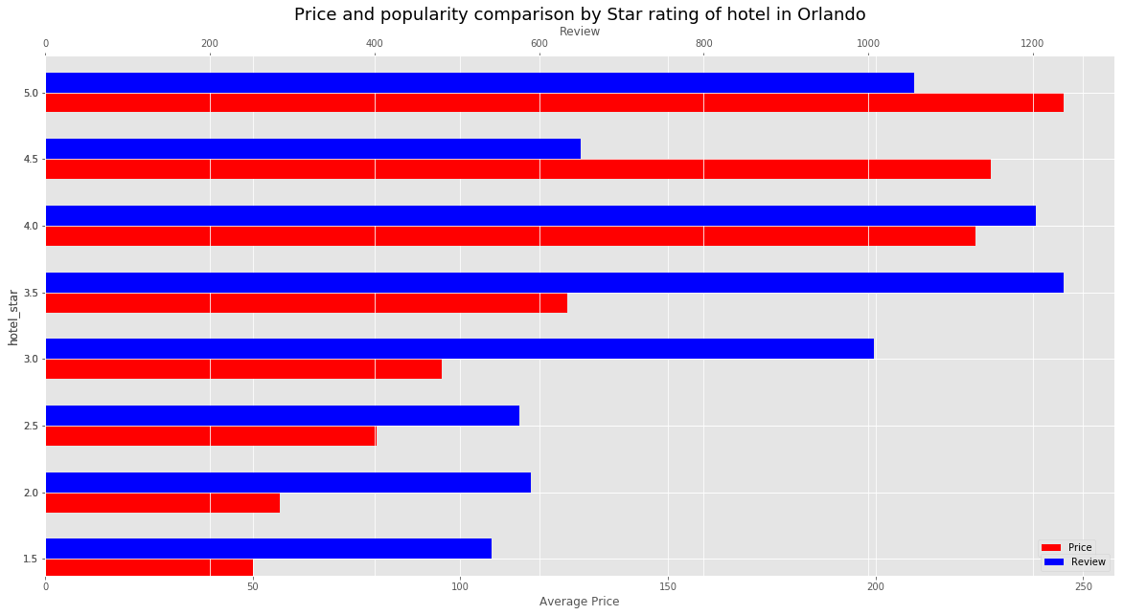
Hotels
Amazing fact: A lot more population in Orlando prefers to book 5 star hotel, well they are priced only on an average of $240 only, plus it’s a family vacation destination that could be one factor. The most popular hotel type is 3.5 star hotels which costs $125 on an average. Whereas in Airbnb, you can go for most popular choices just for $70 in Orlando

Slide 21
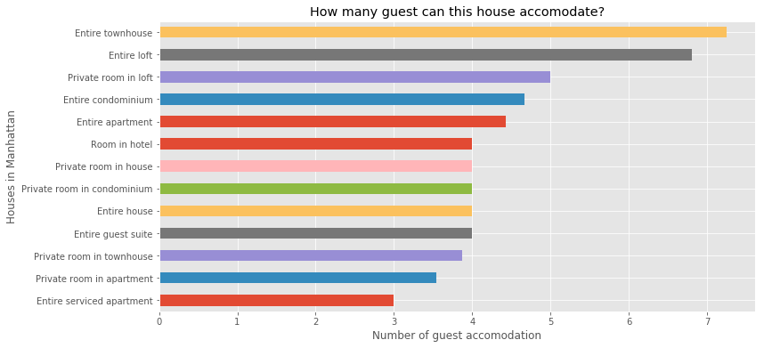
AirBnb
Airbnb rentals can accommodate upto 7-8 guests on an average, Where as 1 Room from hotels.com can serve 2–3 guests usually.
For travelling in large groups, Airbnb can be preferable choice in Manhattan

Slide 22
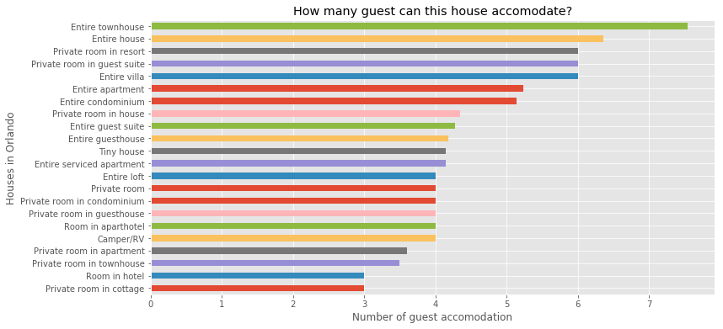
AirBnb
Airbnb rentals can accommodate upto 7-8 guests on an average, Where as 1 Room from hotels.com can serve 2–3 guests usually.
For travelling in large groups, Airbnb can be preferable choice in Orlando.

Slide 23
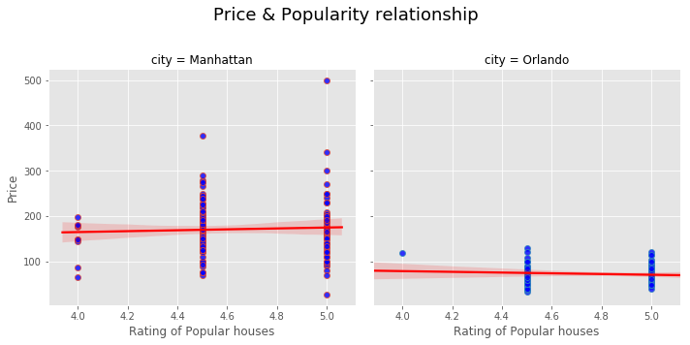
AirBnb
Price and popularity doesn’t seem to have a positive linear relationship

Slide 24
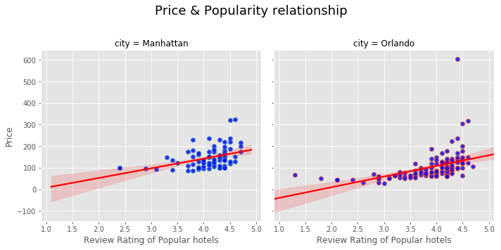
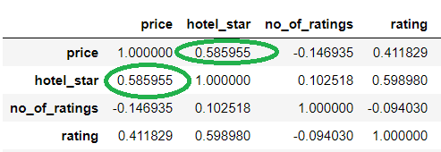
Hotels
Correlation

Slide 25
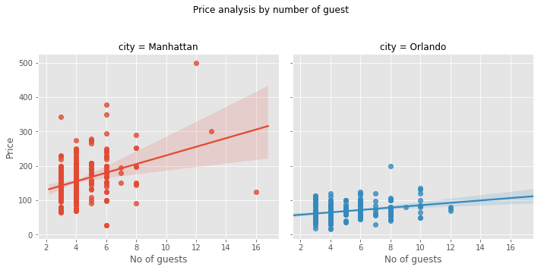
AirBnb
Price and number of guests seem to have a positive linear relationship in Manhattan and Orlando (however, slightly less for Orlando)

Slide 26
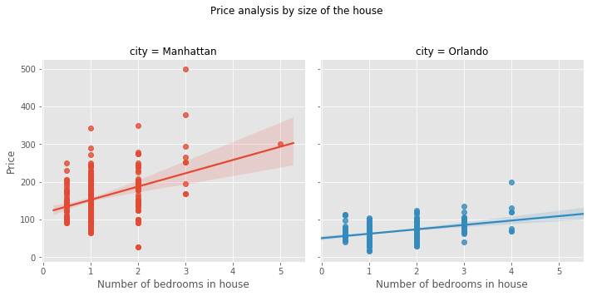
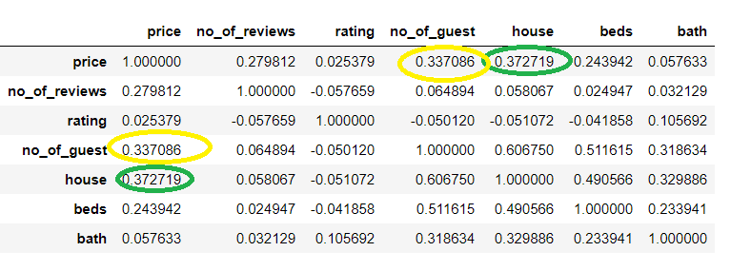
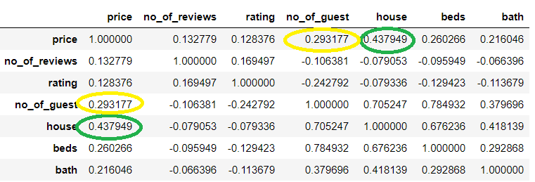
AirBnb
Correlation
Manh
Orlando

Slide 27
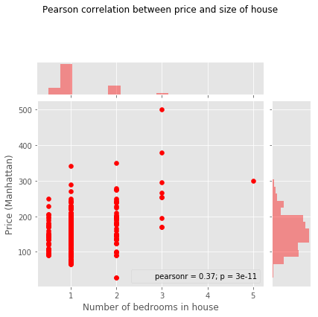
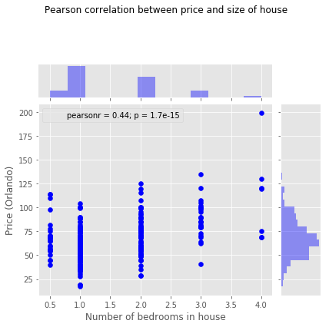
AirBnb
Pearson correlation of these two variables is 0.37
We see that p value is very small which indicates that there is a significant linear relation between Size of house and Price of house
Pearson correlation of these two variables is 0.44
We see that p value is very small which indicates that there is a significant linear relation between Size of house and Price of house

Slide 28
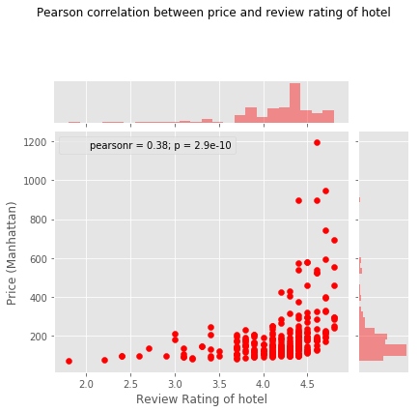
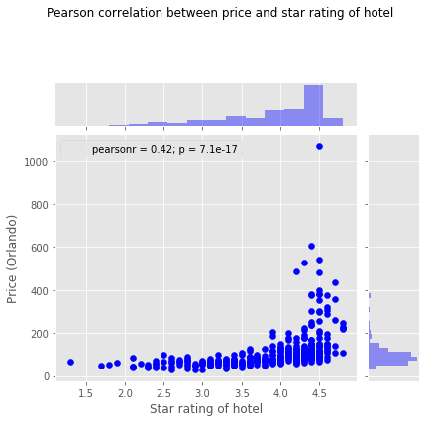
Hotels
Pearson correlation of these two variables is 0.38
We see that p value is very small which indicates that there is a significant linear relation between Review Rating and Price of Hotel
Pearson correlation of these two variables is 0.44
We see that p value is very small which indicates that there is a significant linear relation between Review Rating and Price of Hotel

Slide 29
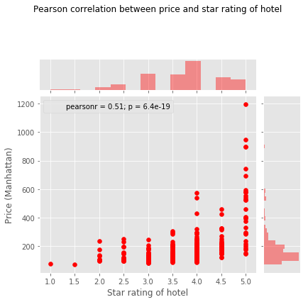
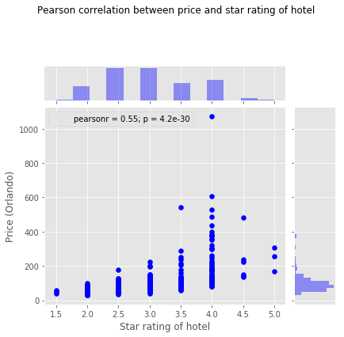
Hotels
Pearson correlation of these two variables is 0.51
We see that p value is very small which indicates that there is a significant linear relation between Star Rating and Price of Hotel
Pearson correlation of these two variables is 0.55
We see that p value is very small which indicates that there is a significant linear relation between Star Rating and Price of Hotel

Slide 30
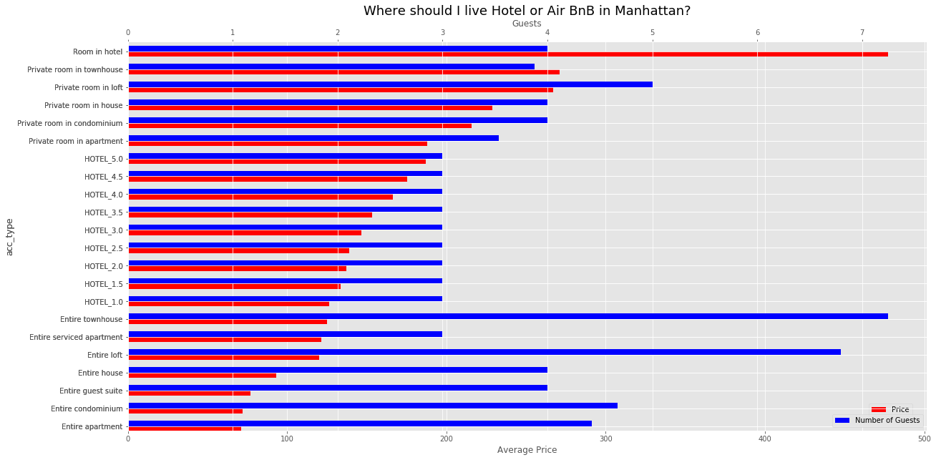
Where should I rent in Manhattan?
Accomodation Type
Factors that contribute to this decision would be how many guest staying together and budget for the trip. For large groups Entire townhouse is the best approach, for small groups average rated hotels can be an option (but they are average.) Airbnb Entire service apartment are highly rated and provides you extra hospitality in less price.

Slide 31
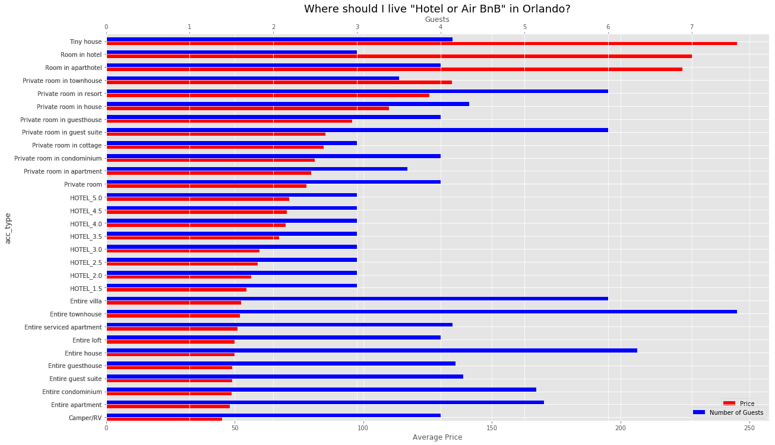
Where should I rent in Orlando?
Accomodation Type
Factors that contribute to this decision would be how many guest staying together and budget for the trip
Factors that contribute to this decision would be how many guest staying together and budget for the trip. For large groups Entire townhouse is the best approach, for small groups average rated hotels can be an option (but they are average.) Airbnb Entire service apartment are highly rated and provides you extra hospitality in less price.

Slide 32
Conclusion
Based on data driven evidence we can conclude that:
Airbnb price has significant positive linear relationship with size of house and number of guest it can accommodate.
Price doesn’t inflate with popularity of rental. Hence, highly rated and popular rentals are not pricey.
Airbnb customers have mostly great things to say. There review ratings (mostly > 4.0) are way higher than hotels average review rating.
Hotels price has significant positive linear relationship with hotel star and popularity of hotel.
Highly rated hotels are costlier than highly rated rentals in Airbnb. However there are average or below average hotels that might be cheaper than Airbnb rentals.
In Manhattan, Airbnb or average star rated hotels are more popular whereas Orlando crowd doesn’t hesitate to appreciate luxury and high price of 5 star hotels.
This analysis didn’t have exact location details to compare (Airbnb provides location only upon confirmation of booking). Location would drive a huge impact on price and choices one can make.
Non data driven facts:
Millennials love Airbnb, its gives you a whole new travel experience as opposed to cookie cutter hotel experience.
Not all rentals at Airbnb are secure, all one needs is an email id and phone number to host a rental whereas hotels come with set level of security.
Hotels come with special packages like kids club, indoor pools etc. due to which a lot of families might still prefer hotel. If Airbnb could improve on specialties, they can expand their business to another level.
Mostly hotels are situated near tourist attraction, Airbnb rental are split across wide location. Both could be a fit based on where you want to tour.

Slide 33
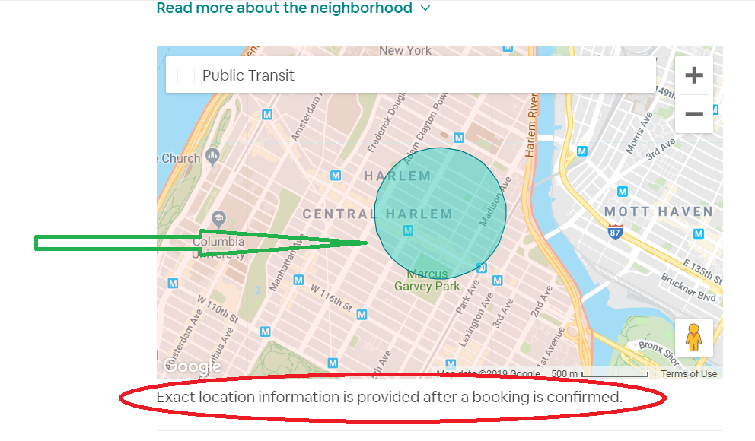
Future Work
Scrape additional fields like amenities and compare which amenities in both kind of businesses.
Create an interactive app in Dash and plug these plots in my app.
Scrape data of locations from west coast and compare.
Scrape latitude and longitude from Airbnb and compare with hotels based on location
Airbnb restricts exact address until booking, but for analysis one could pick the lat and long from href of google map center
https://maps.googleapis.com/maps/api/staticmap?size=648x348&zoom=14&center=40.809,-73.94263&scale=2&path=color%3A0x007A87%7Cfillcolor%3A0x00d1c166%7Cweight%3A1%7Cenc%3AkkbxFl%7ChbMLmEf%40gEbA%7BDxAiDlBqC~BwBlCuAvCu%40zCQzCPvCt%40lCvA~BtBlBpCxAhDbAzDf%40fELlEMlEg%40fEcAzDyAhDmBpC_CtBmCvAwCt%40%7BCP%7BCQwCu%40mCuA_CwBmBqCyAiDcA%7BDg%40gEMmE%3F%3F&client=gme-airbnbinc&channel=monorail-prod&signature=yrtiLAEJzhc1k64ejuAR9PSIi80%3D
My GitHub
https://github.com/priyasrivast/WebscrapingAirBnbAndHotels

Slide 34
Thank You!
Questions?

